Slide 3
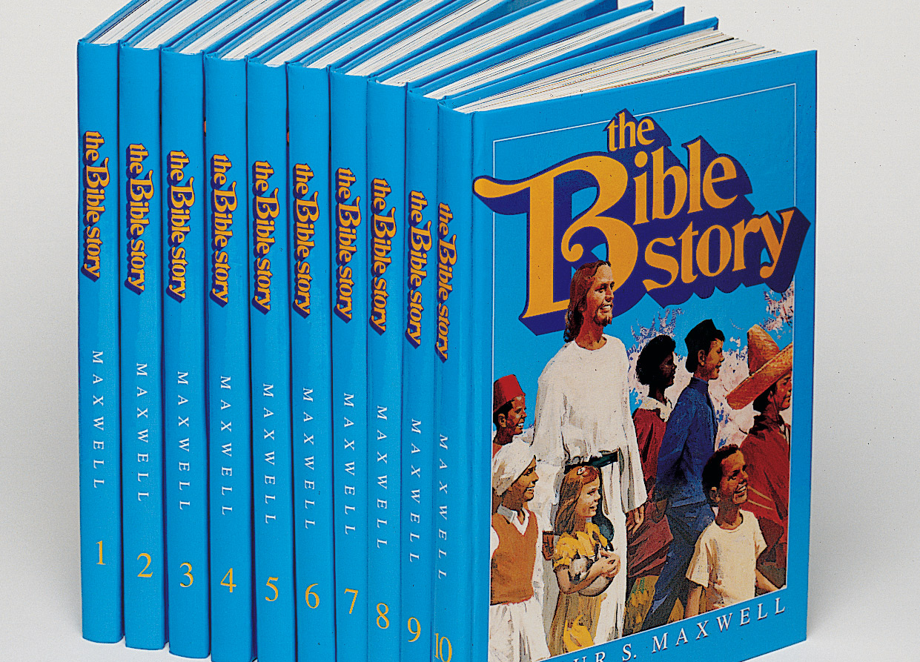
THE 10 Commandments
Exodus 20:1-17
This Photo by Unknown Author is licensed under CC BY-SA
This Photo by Unknown Author is licensed under CC BY-NC-ND
This Photo by Unknown Author is licensed under CC BY-SA
This Photo by Unknown Author is licensed under CC BY
This Photo by Unknown Author is licensed under CC BY

Slide 4
Learning Objectives:
Students will demonstrate an understanding of the 10 Commandments by being able to tell them to family or friends.

Slide 5
Lesson Introduction:
What are some of the rules at your house/school?
What are you allowed to do and not allowed to do?
Do you know that God has rules, too?
We are going to learn about them.
Start with new testament versus then move to old testament
Have the children open their Bibles Exodus 20:1-17.
To help them find it, use the following questions:
Which part of the Bible is Exodus in – Old or New Testament?
Old Testament
What book of the Old Testament is Exodus?
2nd Book

Slide 6
Commandments are rules that God has given us to follow.
Obeying commandments does not earn
our way to heaven, but it pleases God.
God gave the ten commandments to Moses.
Jesus gave us two important commandments.

Slide 7
Jesus’ First Commandment (Loving God)
Love the Lord your God with all your heart,
with all your soul,
with all your mind.
Matthew 22:37

Slide 10
Ten Commandments 1 - 4 (Loving God)
1st Thou shalt have no other gods before me. (Exodus 20:3)
In Bible times an idol was a statue that people believed was a god and worshipped.
an idol can be anything that we make more important than God.
For example: social media, tv, favorite music artist or sports player
Who or what do you do that takes away from your time with God
2nd Thou shalt not take the name of the Lord thy God in vain…Don’t use God’s name in the wrong way. (Exodus 20:7)
Using God’s name as a bad word or in anger is using it the wrong way.
3rd Remember the sabbath day, to Keep it holy. (Exodus 20:8)
The Sabbath should be used to worship God. In Bible times the Sabbath was Saturday, but now we use Sunday as the day of worship and rest.
4th Honor thy father and thy mother that thy days may be long upon the land…..

Slide 12
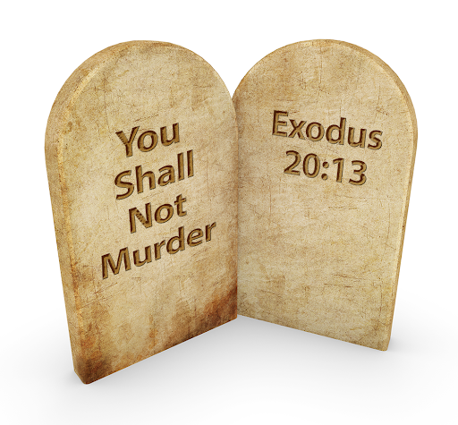

Slide 13
Ten Commandments 5-10 (Loving Others)
Jesus’ Second Commandment (Loving Others)
Love your neighbor as you love yourself. Matthew 22:39
5th Thou shalt not kill (murder).
Don’t hurt anyone
6th Thou shalt not commit adultery
Be faithful to your husband or wife. Don’t treat someone like you are married if you are not
7th Thou shalt not steal
Respect and honor the possession of others

Slide 15
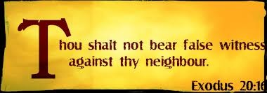
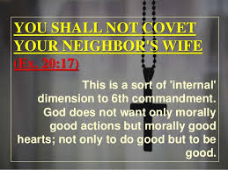
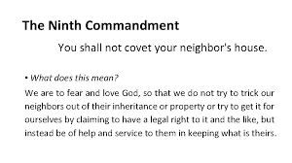

Slide 16
Ten Commandments 5-10 (Loving Others) – Cont.
8th Thou shalt not bear false witness against thy neighbor
Do not lie
9th Thou shalt not covet thy neighbor’s house.
10th Thou shalt not covet thy neighbor’s wife, nor his manservant, nor his maidservant, nor his ox, nor his ass, nor any thing that is thy neighbor’s.
Don’t be jealous of others

Slide 17
